Slide 1
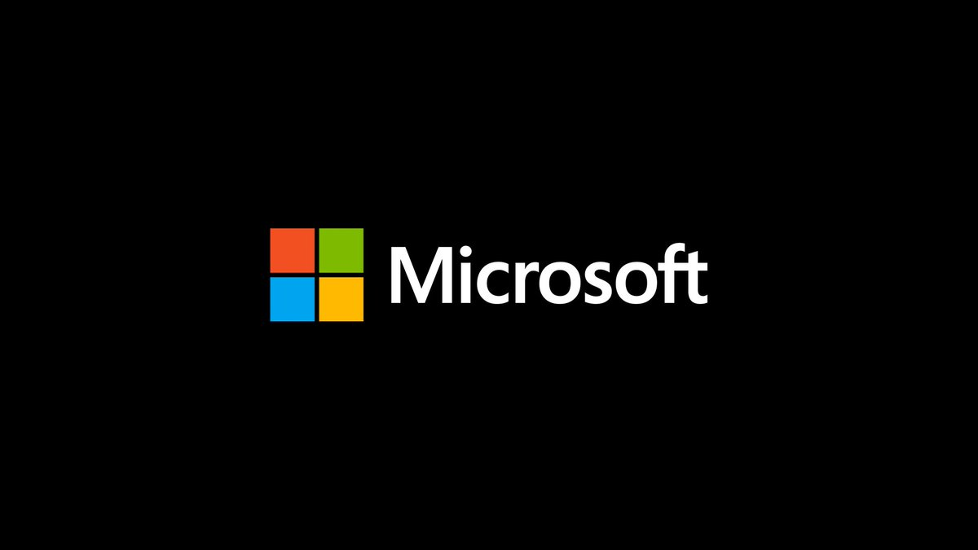


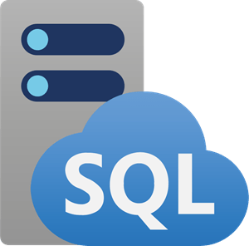
#SQLLovesAI Azure SQL OpenAI Hack
Unlock the potential to query structured data from Azure SQL with Azure OpenAI
Azure SQL OpenAI Hack - 1 day hands-on workshop
Assessing & migrating on-premises SQL Server databases to Azure SQL to unlock scenarios leveraging Azure OpenAI
Identify migration blockers and understand data quality issues as a prerequisite for Azure OpenAI
Learn how to set up and deploy an Azure OpenAI application to query and write back production data to Azure SQL MI with natural language
Dates and locations
09.11.2023 – Microsoft office Berlin
13.11.2023 – Microsoft office Hamburg
16.11.2023 – Microsoft office Frankfurt
20.11.2023 – Microsoft office Munich
Please register here
This workshop is free of charge, delivered by Microsoft Data&AI experts.
Any questions mail to: openai-sql@microsoft.com
Notes:
Guided workshop Azure SQL x Azure OpenAI – Unlock the potential of Data & AI Services | 1 Day | Onsite | Level 300 ‐ Advanced
Azure SQL MIgrathon is a one-day hands-on workshop to give our customers an introduction about how to migrate an SQL database to Azure Managed Instance, Azure SQL monitoring, performance analysis, and some security features. The Azure SQL MIgrathon is designed in a way where introduced theoretical content will directly be performed in practical labs independently by the attendees with expert guidance.
Customers which decide to proceed with database migration wil be eligible for additional free-of-charge offerings from Microsoft.
Agenda
Introduction
Modul 1: Build data foundation by assessing and migrating databases to Azure SQL Family
Modul 2: Deploy OpenAI application, ensure data quality for OpenAI and query Azure SQL with natural language.
Modul 3: Generate actionable insights and persist new data Azure SQL family.
Contact URL: (Will be communicated)
*Customers which decide to proceed with database migration
to Azure will receive a production deployment oversight
guidance for the first migration for free (worth USD 26k) and
can join SQL migration factory program.

Slide 2


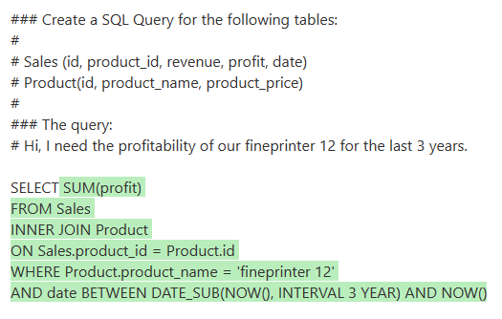
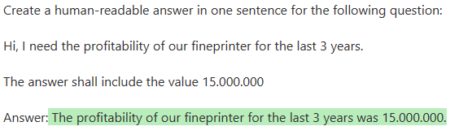
Azure OpenAI example: Ask for structured information
Customer Input
OpenAI Natural Language -> SQL
SQL Server Output
OpenAI Answer
Hi, I need the profitability of our fineprinter for the last 3 years.
$15.000.000
In Red: The variable part of the prompts
Web Application
User Interface and orchestration

Slide 3



Azure SQL MIgrathon data migration from zero to hero
The Future of SQL Server is HERE and YOU can learn it in a single day
Azure SQL MIgrathon - 1 day hands-on workshop
Overview SQL modernization / migration paths
Assessing & migrating SQL Server databases to Azure SQL
Administering & monitoring Azure SQL managed instance
Securing Azure SQL Managed Instance
Additional migration offerings
Dates and locations
12.10.2023 – Microsoft office Frankfurt
17.10.2023 – Microsoft office Hamburg
19.10.2023 – Microsoft office Munich
Please register here
This workshop is free of charge, delivered by Microsoft Data&AI experts.
Any questions mail to: AzureSQLMIgrathon@microsoft.com
Notes:
Guided Azure SQL MIgrathon – Data migration from zero to hero Data Services | 1 Day | Onsite | Level 300 ‐ Advanced
Azure SQL MIgrathon is a one-day hands-on workshop to give our customers an introduction about how to migrate an SQL database to Azure Managed Instance, Azure SQL monitoring, performance analysis, and some security features. The Azure SQL MIgrathon is designed in a way where introduced theoretical content will directly be performed in practical labs independently by the attendees with expert guidance.
Customers which decide to proceed with database migration wil be eligible for additional free-of-charge offerings from Microsoft.
Agenda
Introduction
Overview SQL modernisation / migration paths
Assessing & migrating SQL Server databases to Azure SQL
Administering & monitoring Azure SQL managed instance
Securing Azure SQL Managed Instance
Additional Offerings for Migration*
Contact URL: (Will be communicated)
*Customers which decide to proceed with database migration
to Azure will receive a production deployment oversight
guidance for the first migration for free (worth USD 26k) and
can join SQL migration factory program.

